Slide 1
Shahid Hussain
01-243211-009

Slide 2
Presentation topic
Modular Software Model Checking for Distributed Systems
(Watcharin Leungwattanakit, Cyrille Artho, Masami Hagiya, Yoshinori Tanabe,Mitsuharu Yamamoto, and Koichi Takahashi)

Slide 3

Introduction
Problems
Experiment
Conclusion

Slide 4
Introduction
Model checking is a technique to detect property violations in a concurrent system by exploring every possible execution path.
model checking is a method for checking whether a finite-state model of a system meets a given specification.
A simple model-checking problem consists of verifying whether a formula in the propositional logic is satisfied by a given structure.

Slide 5
Abstract
Distributed systems are complex.
Execution and inter-process communication in these systems are prone to errors
Difficult to detect by traditional testing.
Does not cover every possible program execution.
Model checking verifying one process at a time and running other processes in another execution environment.

Slide 6
Model Checking
Model checking is a technique for concurrency analysis
systematically explores the entire state space of a system.
The system specification defines a set of properties that must hold for a particular system
Model checking verifies whether the specification holds
A tool that performs this verification is called a model checker

Slide 7
Where to use
Mathematical logic,
Programming languages,
Software and Hardware design,
Theoretical computer science

Slide 8
Model checking in Programming languages
Verification on real code gives more software safety
Many concurrency-related faults are introduced by programming mistakes during the implementation phase, such as race conditions, deadlocks etc
Verification in the design phase cannot guarantee the absence of faults in the final deliverables
Software model-checking focuses on the analysis of real implementations
Careful verification on both the system design and the system implementation is important in software development.

Slide 9
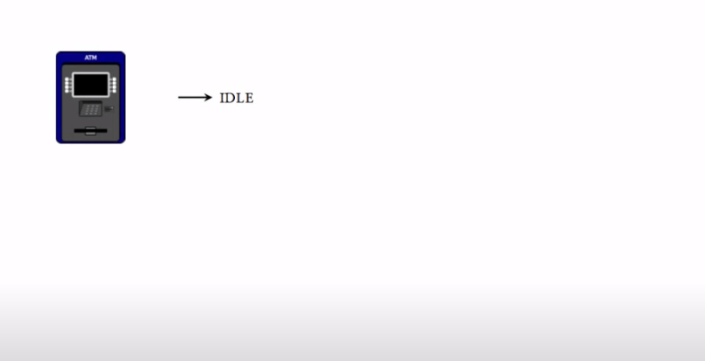
Modeling code behavior

Slide 10
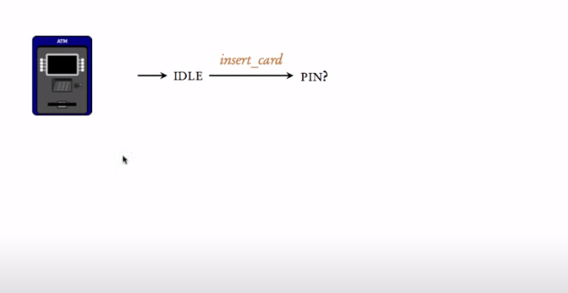
Modeling code behavior

Slide 11
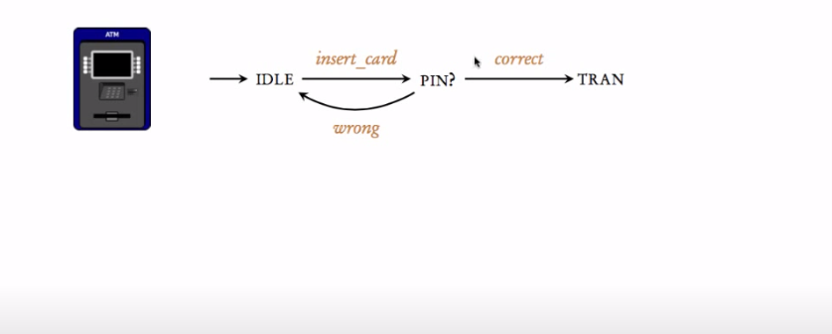
Modeling code behavior

Slide 12
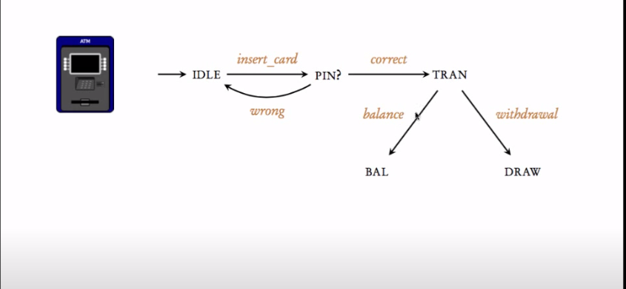
Modeling code behavior

Slide 13
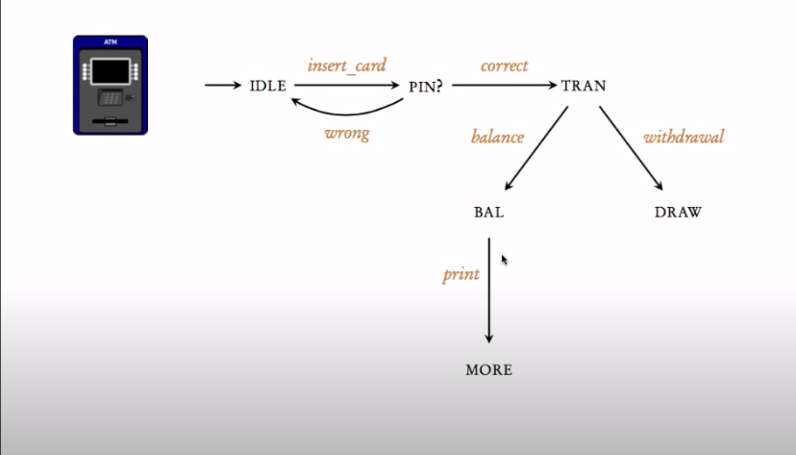
Modeling code behavior

Slide 14
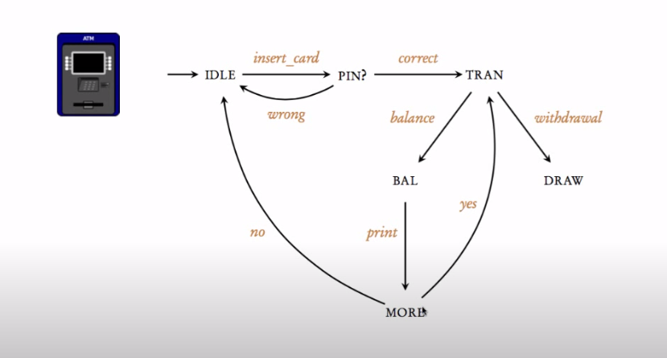
Modeling code behavior

Slide 15
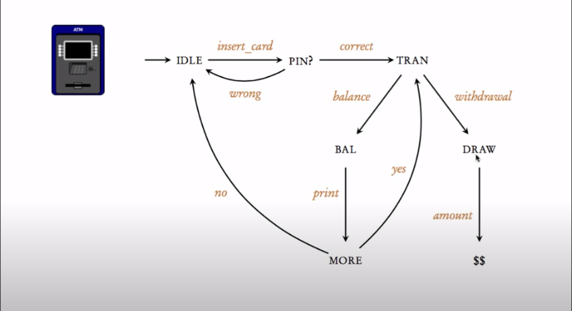
Modeling code behavior

Slide 16
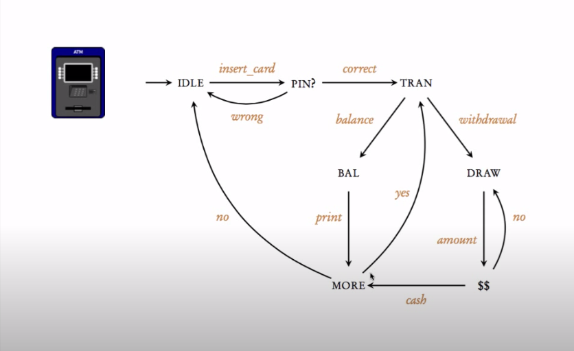
Modeling code behavior

Slide 17
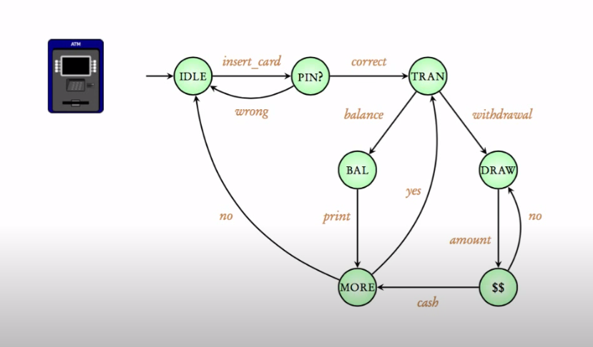
Modeling code behavior

Slide 18
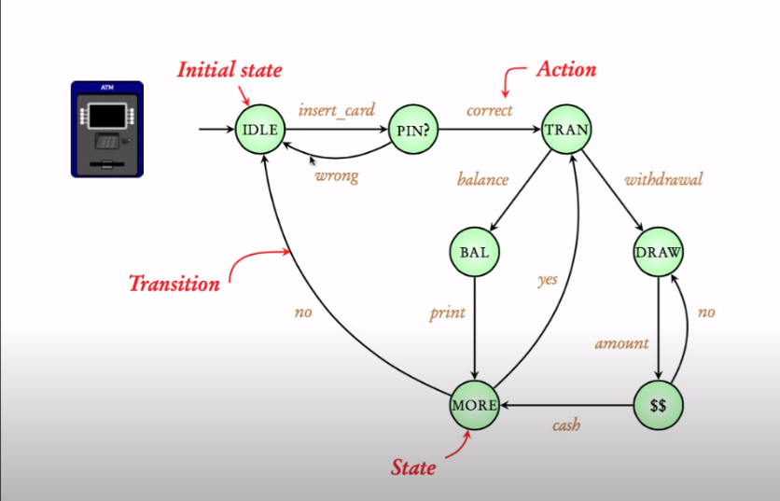
Modeling code behavior

Slide 19
Problems
State Explosion Problem
Too many processes
Data Paths

Slide 20
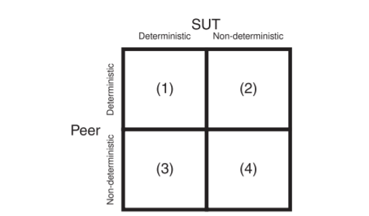
STATE SYNCHRONIZATION
1 - Classification of Applications
Composed SUT and a peer process
Deterministic or non-deterministic

Slide 21
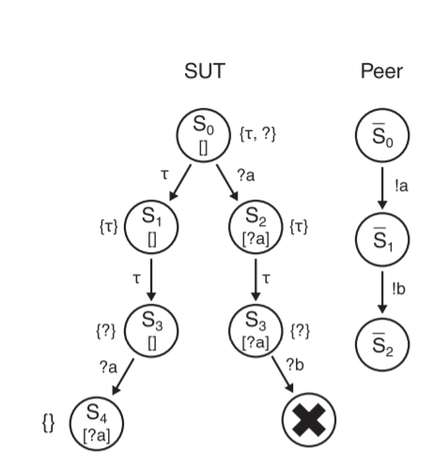
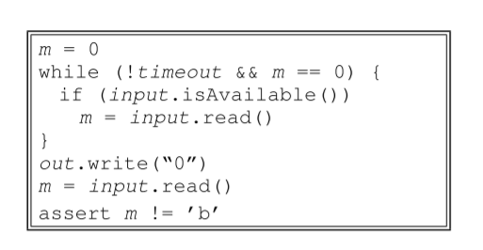
2 - Trace Convergence
Event traces with different messages leading to the same SUT state

Slide 22
EXPERIMENTS
Experimental Environment
  8-core Mac Pro workstation
  24 GB physical memory
  Ubuntu 10.10
  Run on single machine to prevent network latency.

Slide 23
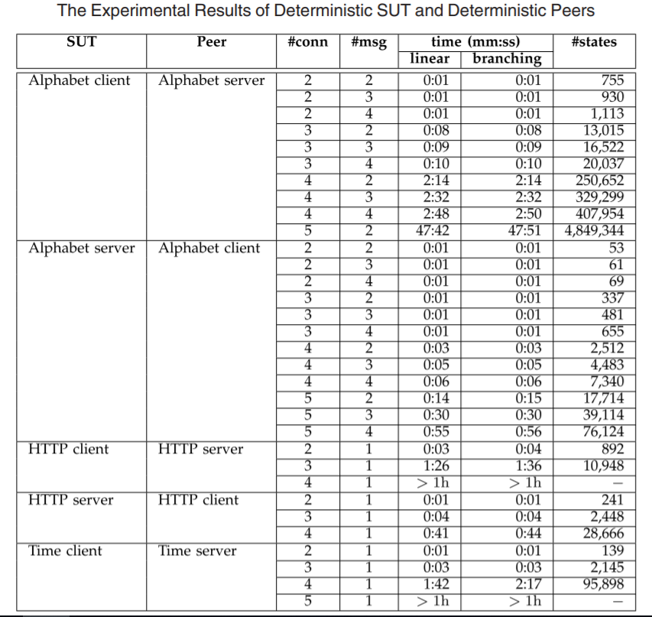
Results
Two data structure linear and branching compared
SUTs used in this experiment do not produce any non-deterministic outputs

Slide 24
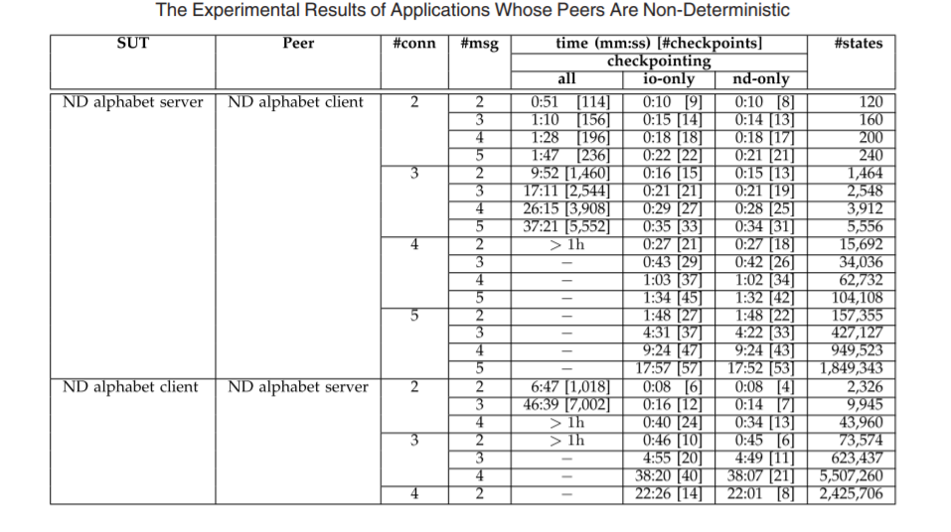
Results
Only hybrid checkpointing is applicable.
Three checkpointing are compared
“All” strategy create checkpointing for SUT state
Io-only and nd-only reduce checkpointing during verification

Slide 25
CONCLUSION
Distributed systems are complex due to non-deterministic element such as interleaving between process and threads.
Software model checking is used to detect faults by exploring every possible path in a systems

Slide 26
References:
E.M. Clarke and E.A. Emerson. Design and synthesis of synchronization skeletons using branching time temporal logic, In: Proceedings of the Workshop on Logics of Programs, vol. 131 of LNCS, pages 52-71. Springer-Verlag, 1981.
Simson Garfinkel. History's worst software bugs. (If for some reason the link does not work, I keep a local copy of the article here.)
A. Pnueli. The temporal logic of programs. In: Proceedings of the 18th IEEE Symposium on the Foundations of Computer Science, pages 46-57, 1977.
A.N. Prior. Time and Modality. Oxford: Clarendon Press, 1957
J.P. Queille and J. Sifakis. A temporal logic to deal with fairness in transition systems. In: 23rd Annual Symposium Foundations of Computer Science, pages 217--225, 1982.
E.M. Clarke, O. Grumberg and D. Peled. Model Checking. The MIT Press, 1999.

Slide 27
Thanks

